Slide 1
TTU CS Blog
James Little
Jason Weber
Patrick Braud
Randall Harper

Slide 2
Introduction
TTU CS Blog will be a community hub where students can reach out to peers seeking advice ranging anywhere from class topics to research. Anyone can visit the forums, but only registered users may post a question to the community. Users will be able to search through the forums for specific topics.

Slide 3
Functionality
Actors in the system are labeled as ‘registered user’, ‘guest’, ‘faculty’, or ‘administrator’.
Everyone can post in the forums except for guests.
Posts will fall under different topics ranging from programming languages to course discussions.
Everyone can search the forums.
Posting questions will run off a points system. Users will need points to post a questions in the forums. Points will be awarded back to users for correct answers.

Slide 4
Terminologies and Abbreviations
TTU – Texas Tech University
CS - Computer Science
WAMP - A Windows Web development environment for Apache, MySQL, and PHP databases
AWS – Amazon Web Services
MySQL – an open source relational database management system.
MAMP – A Macintosh Web development environment for Apache, MySQL, and PHP database

Slide 5
Functional Requirements
They system shall have users.
The system user roles will be registered, guest, faculty, or an administrator.
The system users will have a photo associated with their accounts.
The system user ‘guest’ will not have a photo.
The system shall have a home page.
The system home page will have blog links, a search bar, and topics.
The system shall allow users to search the blog.
The system shall allow any user to search under any topic.

Slide 6
Functional Requirements
They system shall allow users to make posts.
The system users will have different access to posting.
The system user ‘guest’ will not have access to post.
The system users ‘faculty’ will only post under research topics and articles.
The system shall maintain a total number of topics and courses.
The system users will have different topics and courses to post to.
The system users will gain credit for correctly answering a posted question requested by another user.
The system user ‘administrator’ will have to authority to close or move a post.
The system shall automatically email the user who made a post when another user has attempted to answer.
The system shall mark each post as answered or unanswered.
The system shall close a post if it remains unanswered after the time out period.

Slide 7
Role Assignment
Name | Role
James Little | Back end
Jason Weber | Documentation
Patrick Braud | Front end
Randall Harper | Testing

Slide 8
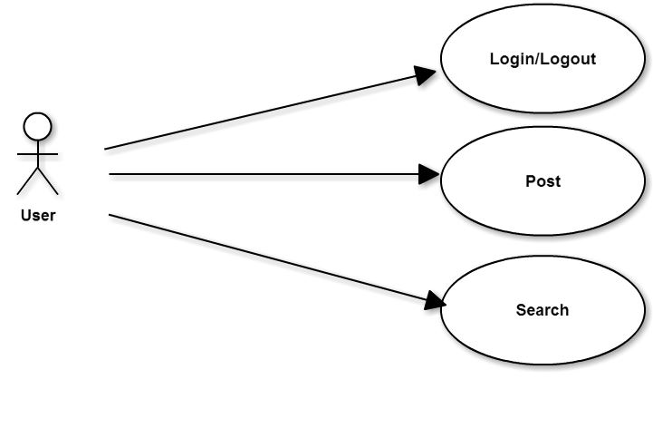
Use Case Model

Slide 9
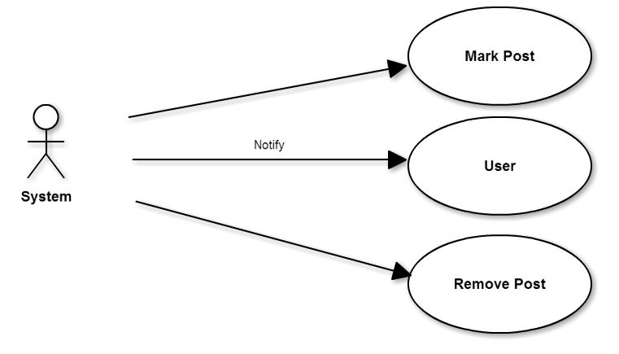
Use Case Model

Slide 10
Non-Functional Requirements
Security: The system should have password encryption for its users.
Performance:
Response Time: The response time of the webpage will only be limited by the user’s internet connection. However, it will not take longer than 1 second to scroll up or down a webpage in the domain.
Resource Usage: The webpage should not affect the system any differently than another similar webpage. Different web browsers may produce a different amounts of resources used.

Slide 11
Non-Functional Requirements
Reliability: The system should be accessible 99% percent of the time. The other one percent will be allotted for any server updates or maintenance.
Usability: The webpage should be usable by anyone with basic computer skills.
Implementation Constraints:
Language: The system will be written in the PHP programming language.
Operating Systems: The system will be available on Windows operating systems as well as Macintosh, since it is written in PHP.

Slide 12
Questions?

